Slide 1



WelcoMe

Slide 2













assistant Teacher
Oskhali aaliya Model gov’t Primary School.
hatiya,Noakhali

Presented by

Slide 3

LeSSON idENTiTY
Class - One
Todays lesson:
Sub - English
Lesson – 8
Time -45m
date -24 / 6 / 13

Slide 4
Learning out comes :
٭٭٭٭٭٭٭٭٭٭٭٭٭٭٭٭٭٭٭٭٭٭٭٭٭٭٭٭٭٭٭٭٭٭٭٭٭٭٭٭
☞ Students will be able to…….
❒ Video of the item can say.
❒ recite the rhyme with correct pronounciation .
❒ recite the rhyme with act .

Slide 5


Safe learning environment
5 minutes



Slide 6
§§§§§§§§§§§§§§§§§§§§
Nor is it the video?
 discussion group
§§§§§§§§§§§§§§§§§§§§

Slide 7

diclaration of the
Title
One,Two
Buckle My Shoe

Slide 8
Presentation
( input )
Time: 20 minutes

Slide 9


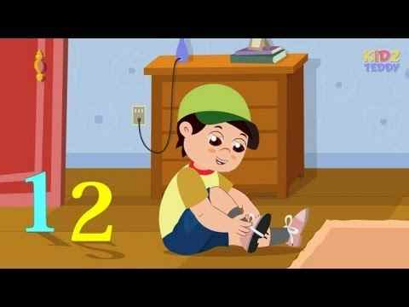
One, two,
buckle my shoe;

Slide 10

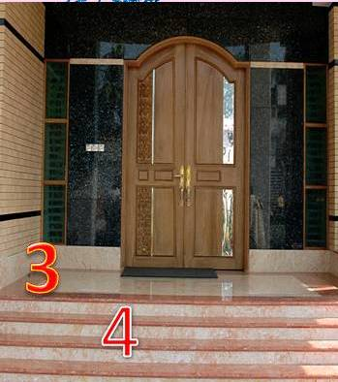
3
4
Three, four,
Shut the door ;

Slide 11
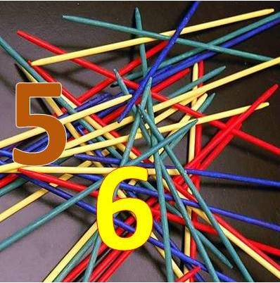
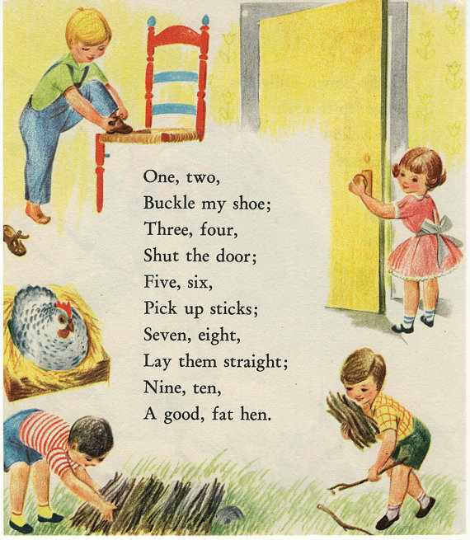
five, six,
Pick up sticks ;

Slide 12
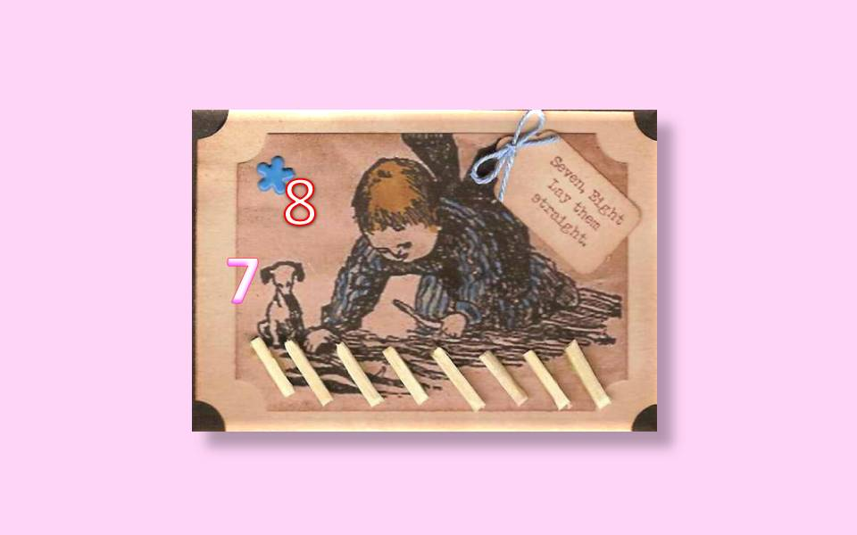
Seven, eight,
Lay them straight ;

Slide 13
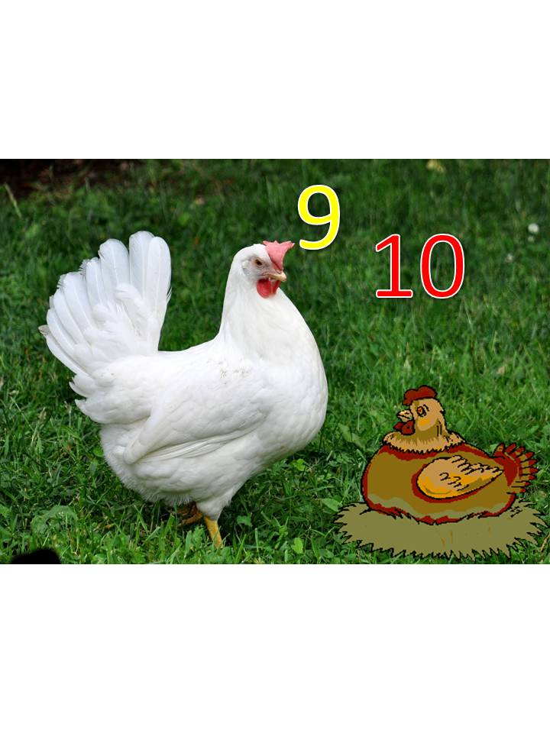
Nine, ten,
a big fat hen.

Slide 14










One
Ten
Two
Nine
Three
Eight
Four
Seven
Five
Six

Slide 15
( Practice )
Time: 10 minutes

Slide 16
Open your book ( page no: 51 )
Teachers recitation
than
Students group recitation .
♣♣♣♣♣♣♣♣♣♣♣♣♣♣♣♣♣♣♣♣♣♣♣♣♣♣♣♣♣

Slide 17
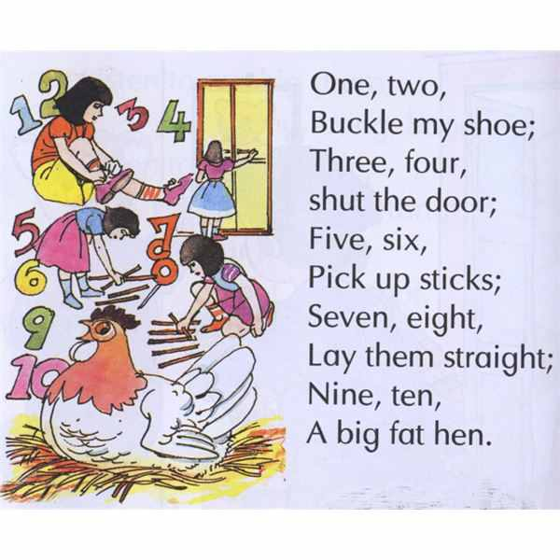

Compare this lines with your book



Slide 18
group work ­ 5m .
⬇
One group recite,another group listen.
❂❂❂❂❂❂❂❂❂❂❂❂❂❂❂❂❂❂❂❂❂❂❂❂❂❂❂❂❂❂❂❂❂❂❂❂

Slide 19
Checking learning
Time: 10 minutes

Slide 20
*****
*****
Students recitation
One by one

Slide 21
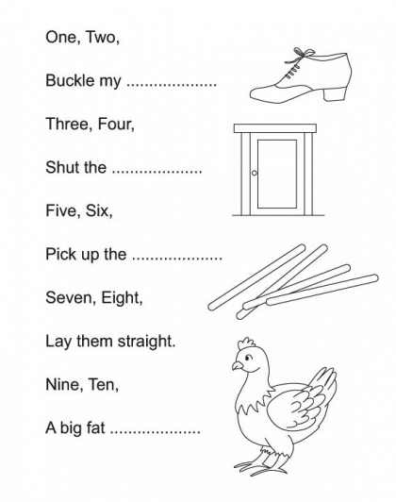
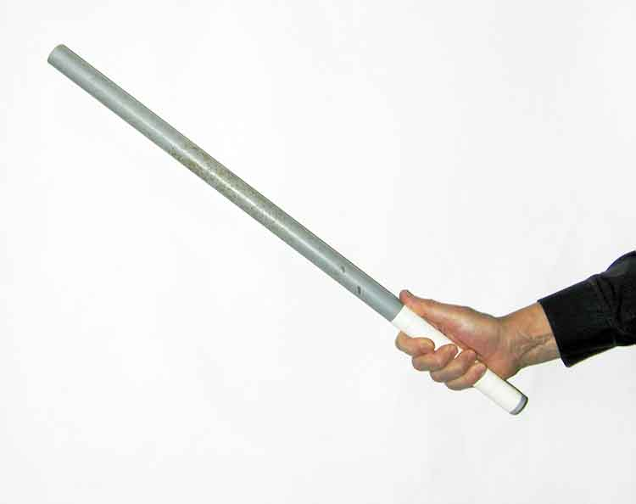
Complet the sentence (W.C.W )
One, two,
buckle my………….
○
○
door
○
○
Three, four,
Shut the……………....
sticks
○
○
○
five, six,
Pick up ……………….
shoe
○
○

Slide 22
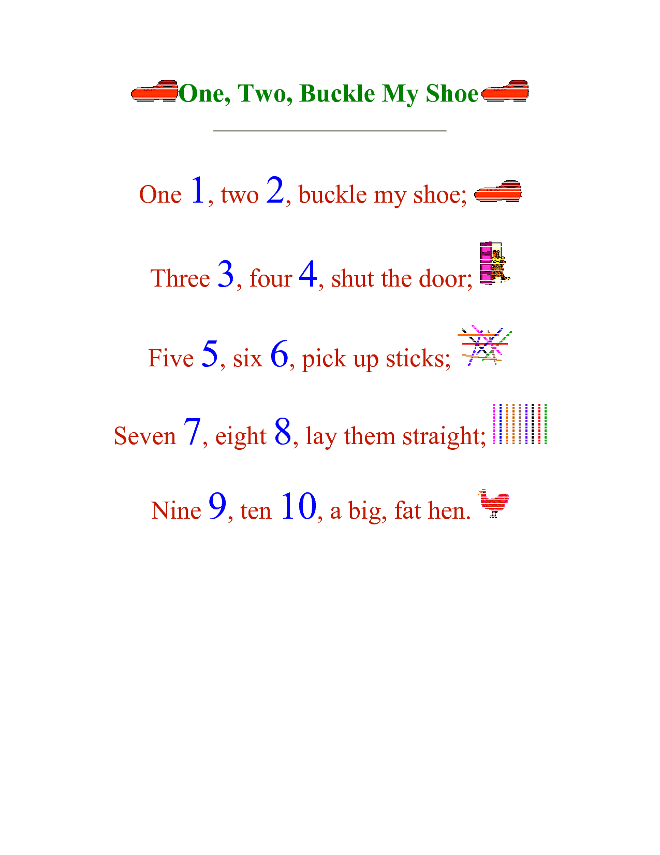
Read ( i .W.)
One,two,
buckle my shoe
five, six,
Pick up sticks ;
Three,four,
Shut the door ;
Seven, eight,
Lay them straight ;
Nine, ten,
a big fat hen.
§§§§§§§§§§§§§§§§§§§§

Slide 23

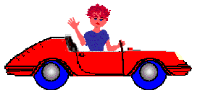
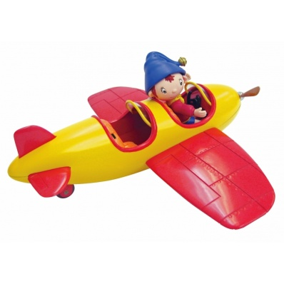
See you later
all the best

